Slide 1
Airbnb Project
Predicting price of Airbnb listing using data

Slide 2
About Dataset
4 Tables – calendar, hosts, listings and reviews
Calendar – Consists of price, availability, etc. of each listing over the course of the entire time period
Hosts – Details of each host, like name, host since, location, about, etc.
Listings - Details of each listing. Includes information like latitude, longitude, number of bathrooms, beds, etc.
Reviews – List of customer reviews. Has columns for listing ID, reviewer ID, review comments, etc.

Slide 3
Data that was excluded
Firstly, the data in reviews table was not used. The data in this table would be very difficult to convert into a form that can be used as input for regression models. This table was hence not included in the data.
Calendar – Calendar ID, Adjusted Price were not used. The first is a simple counter, and does not have any information. The second column is a near identical copy of Price column, and was hence removed.

Slide 4
Data that was excluded
Hosts – Host name was not included, as this column does not really help in predicting the price of a listing. Host location and about were also dropped for this reason.
Listings – Listing URL was removed. The URL of a listing would not help in determining its price. The same logic can be applied to the Name of the listing, at least to some extent. The description and Host ID were also dropped from this table.
Some of the dropped text columns could have helped us to get “keywords” that might help in predicting the price of a listing, but again that would require a lot of processing, and we already have a very good model without using such advanced techniques.

Slide 5
Data Pre-processing Highlights
Important correlations – The target column is noticeably correlated with two columns – Accommodates and Bedrooms. This seems intuitive as well – rooms that house more people or have more bedrooms would normally be more expensive.
Extracting number of bathrooms from ‘bathrooms_text’ – The bathrooms_text column had some simple text to indicate the number of bathrooms. To process the data, the words were dropped and the column was converted into numerical values.
Missing values were present in Bedrooms, Beds, and Price. They were replaced by appropriate central values.

Slide 6
Data Pre-Processing Highlights
Encoding categorical variables – At this point, there were two categorical variables: Property Type, and Room Type. They were encoded using dummy encoding.
Date-Time variables – These were converted to UNIX timestamps to make them numerical. There were two such columns: Host since and Date.
Amenities – The data in Amenities column was formatted as a list. A column was created for each unique amenity, and if a listing had that amenity, the corresponding column’s value was set to 1. This added a lot of columns to the dataset, and later these columns were dropped due to not contributing much to overall model scores, and to reduce complexity.

Slide 7
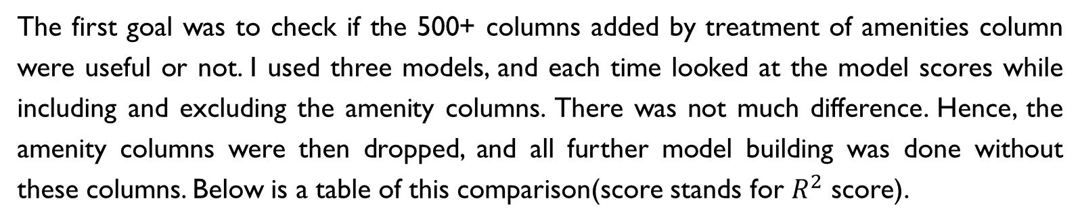
Model Building and evaluation
The first goal was to check if the 500+ columns added by treatment of amenities column were useful or not. I used three models, and each time looked at the model scores while including and excluding the amenity columns. There was not much difference. Hence, the amenity columns were then dropped, and all further model building was done without these columns. Below is a table of this comparison(score stands for $R^{2}$ score).
Model | Score with Amenity Columns | Score Without Amenity Columns
Linear Regression | 22.96% | 22.96%
Decision Tree Regression | 98.69% | 98.7%
Random Forest Regression | 99% | 99.03%

Slide 8
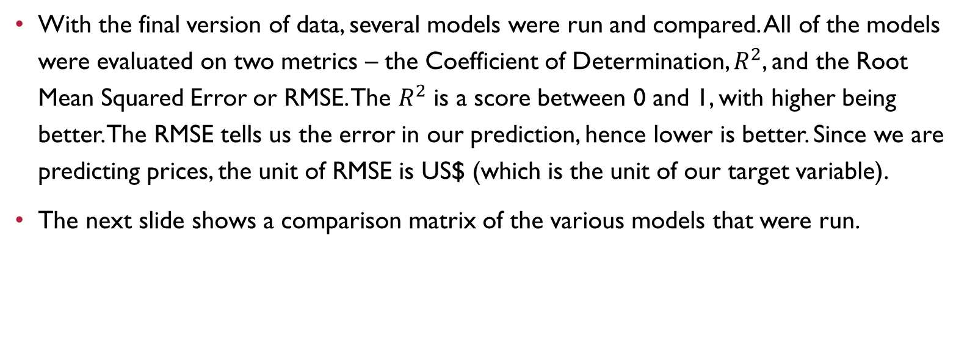
Model Building and Evaluation
With the final version of data, several models were run and compared. All of the models were evaluated on two metrics – the Coefficient of Determination, $R^{2}$, and the Root Mean Squared Error or RMSE. The $R^{2}$ is a score between 0 and 1, with higher being better. The RMSE tells us the error in our prediction, hence lower is better. Since we are predicting prices, the unit of RMSE is US$ (which is the unit of our target variable).
The next slide shows a comparison matrix of the various models that were run.

Slide 9
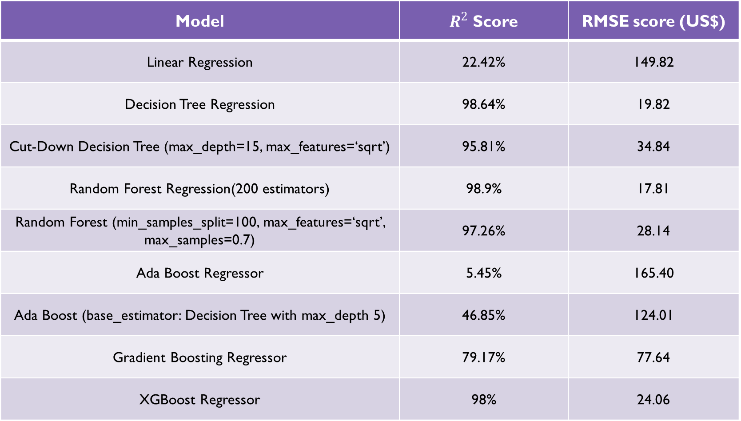
Model | $R^{2}$ Score | RMSE score (US$)
Linear Regression | 22.42% | 149.82
Decision Tree Regression | 98.64% | 19.82
Cut-Down Decision Tree (max_depth=15, max_features=‘sqrt’) | 95.81% | 34.84
Random Forest Regression(200 estimators) | 98.9% | 17.81
Random Forest (min_samples_split=100, max_features=‘sqrt’, max_samples=0.7) | 97.26% | 28.14
Ada Boost Regressor | 5.45% | 165.40
Ada Boost (base_estimator: Decision Tree with max_depth 5) | 46.85% | 124.01
Gradient Boosting Regressor | 79.17% | 77.64
XGBoost Regressor | 98% | 24.06

Slide 10
Finalized model
As is evident from the table on the preceding slide, Random Forest Regressor gives us the highest score on both metrics, followed closely by Decision Tree and Gradient Boosting. These scores are calculated on the test set, and remained fairly consistent across multiple runs of the code (the train-test split was done again for each run). It is safe to conclude, hence, that these high scores are not due to overfitting, at least to some extent. We do have some level of data leakage as pre-processing was done first and the dataset was split later into training and testing sets. Even so, such high scores means we have an excellent model for predicting the price within a small margin of error.

Slide 11
Top predictors
Using data from the feature_importances_ attribute of the random forest object, we find that the following columns are the top 5 predictors:
Feature Name | Importance
Property Type – Private Room in Townhouse | 0.276067
Property Type – Entire Vila | 0.142162
Accommodates | 0.075672
Bathrooms | 0.068826
Beds | 0.065905

Slide 12
Conclusion
Using some basic data manipulation and processing techniques, we were able to create a small but highly efficient set of predictors for our target variable. We have a total of 54 predictors, which can probably be cut down even further by eliminating those predictors which have low importance.
The Random Forest model is giving us around 99% score, which means it is a very good model for predicting the price of a listing, and can do so with an average error of $17.81.
Simpler models like Decision tree are also giving us a very good score, and using some hyperparameter tuning to prevent overfitting can ensure we have a much simpler model that is still a very good predictor. This may be useful if the prediction needs to be done in a scenario where efficiency is paramount.

